Slide 1

Goal Setting & Career Path

Slide 2

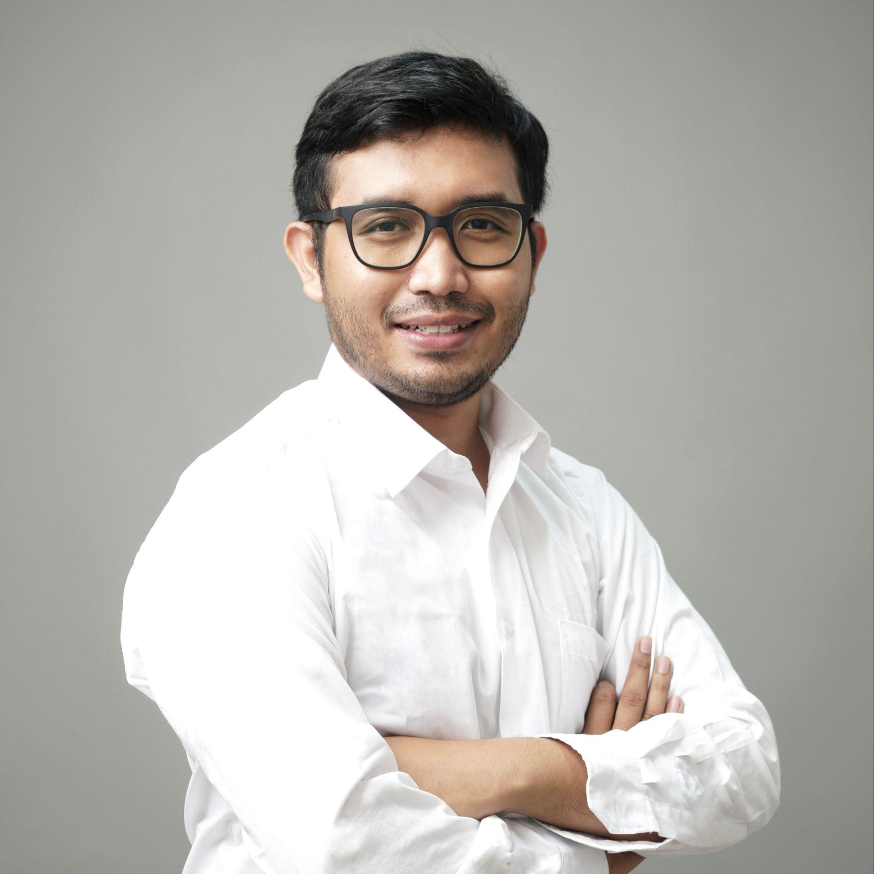
Chief People Officer
at Travel & Education Holding Company (2023-Present)
Management Consultant
Yahya Aditya
at Human Plus Institute (2023-Present)
Mentor
HR Strategic Manager
at FishLog (2022-2023)
Strategic Management Consultant
Training and Development Manager
at Halodoc (2021-2022)
LinkedIn:
(Yahya Aditya)
People Development Section Head
at Pamapersada Nusantara (2016-2021)

Slide 3

Apa 1 hal yang kalian ingin capai
dalam karier kalian tahun ini?

Slide 4

Mengapa tujuan itu penting?
Apa yang terjadi jika kita tidak punya tujuan yang jelas?

Slide 5


Mengapa tujuan itu penting?
Gambar 1
Gambar 2
Apa Bedanya?

Slide 6
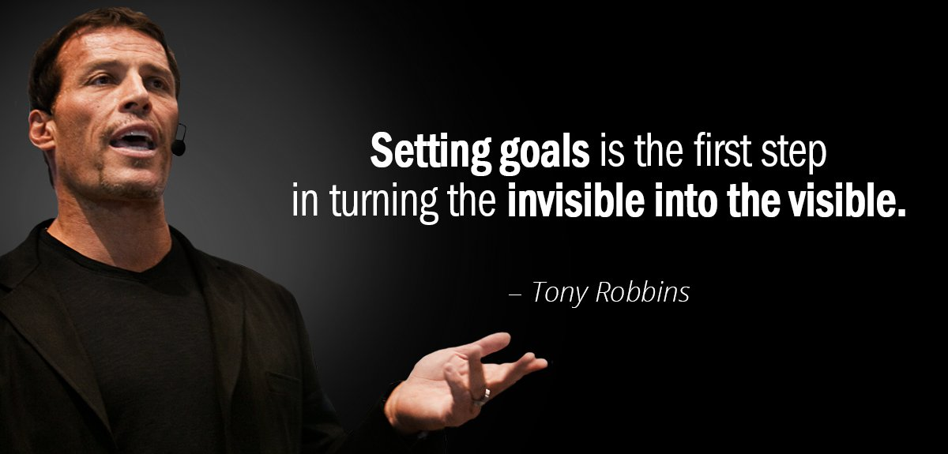

Slide 7


Slide 8
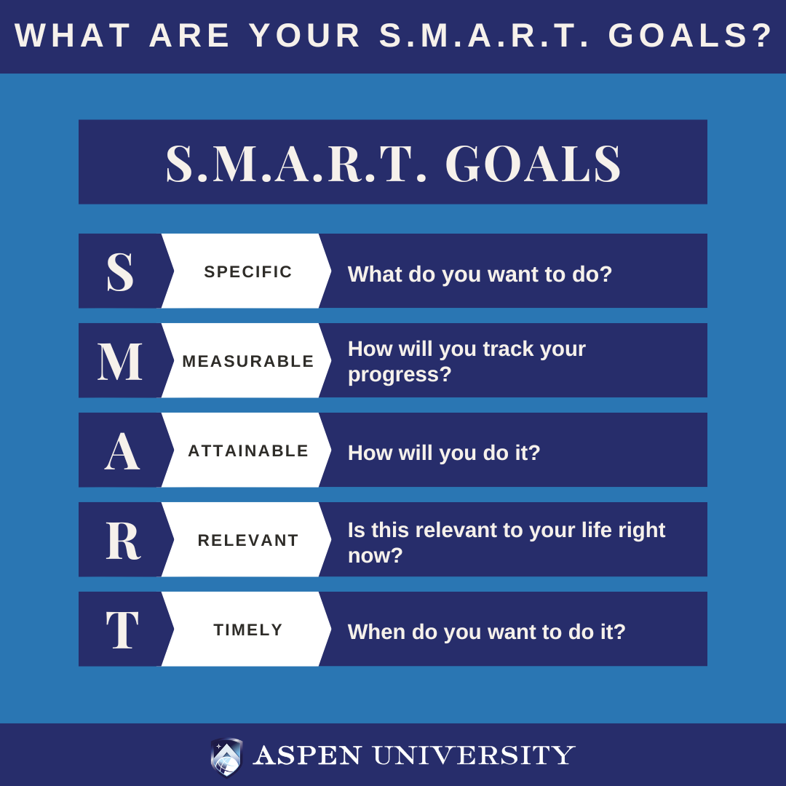

Slide 9
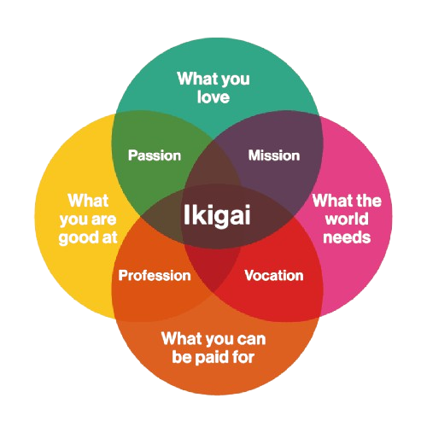
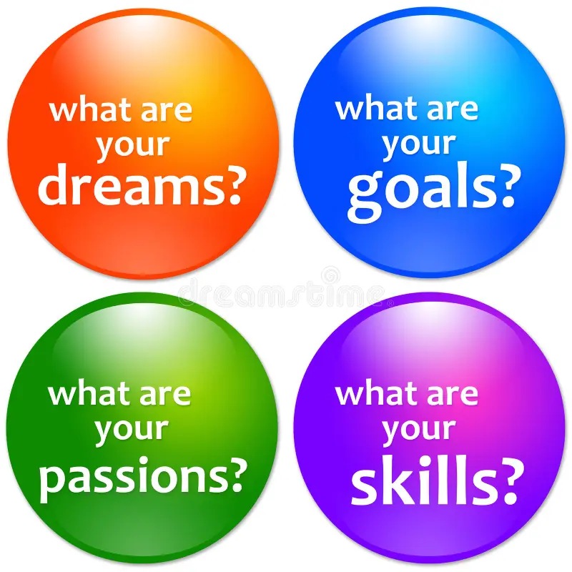
Personal Strengths, Passion, Values?

Slide 10
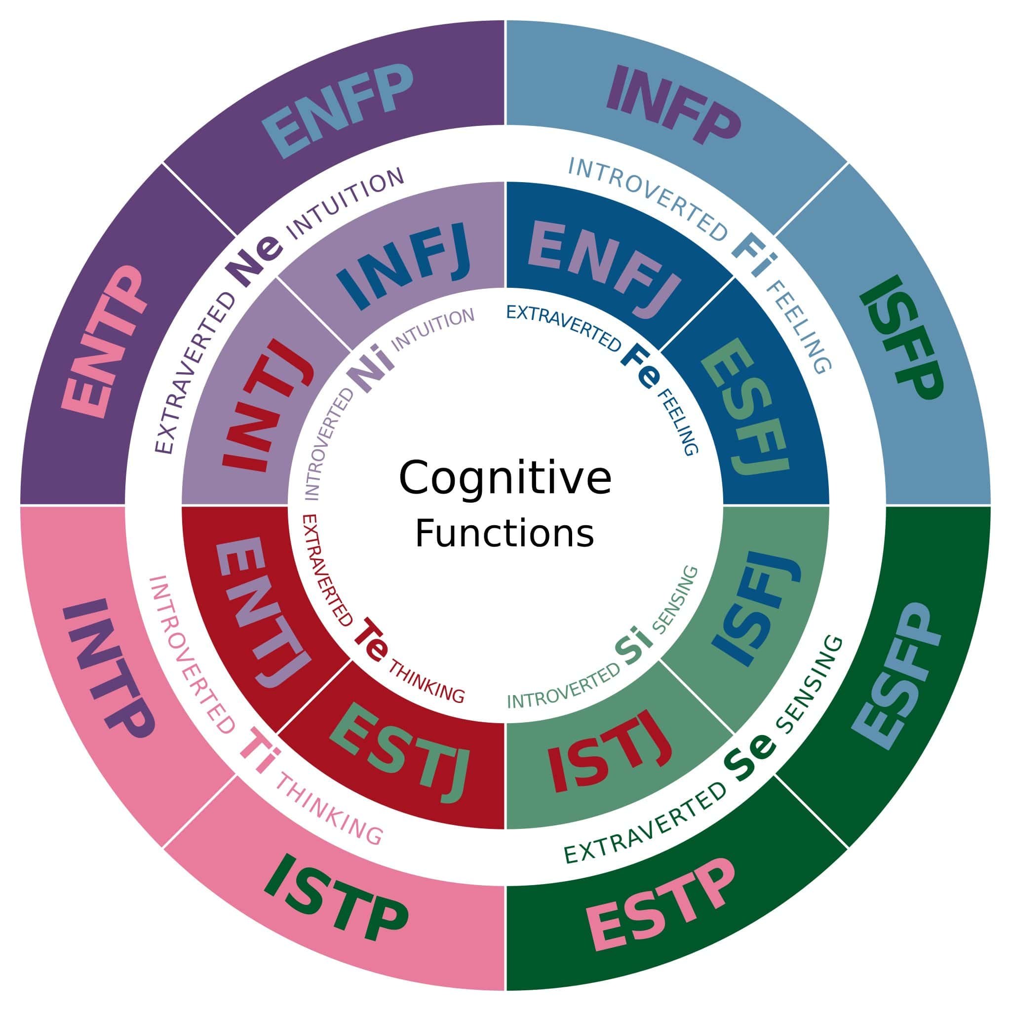
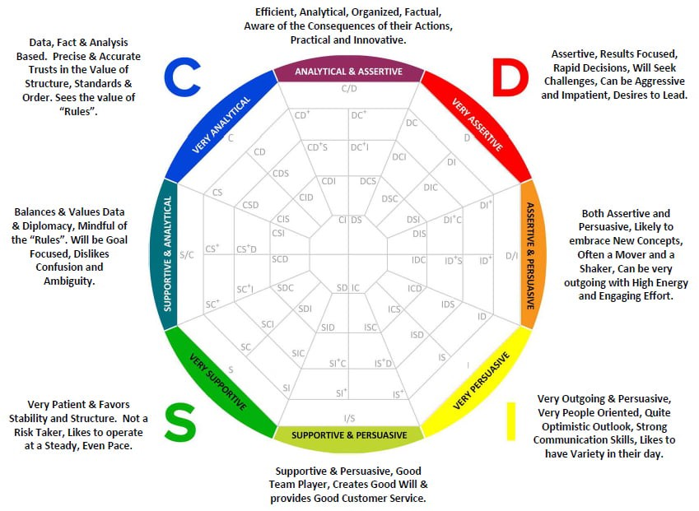
Who are you ?
*If you need to more deep dive who are you, you can contact me

Slide 11
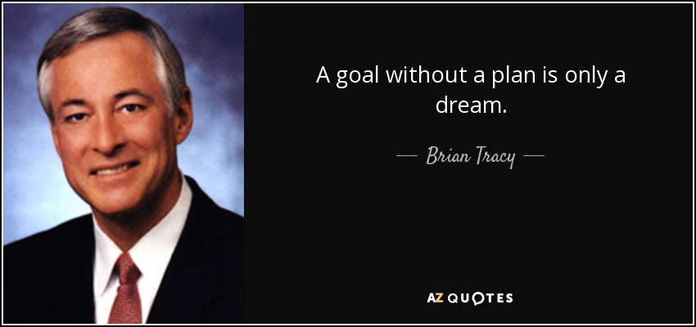

Slide 12
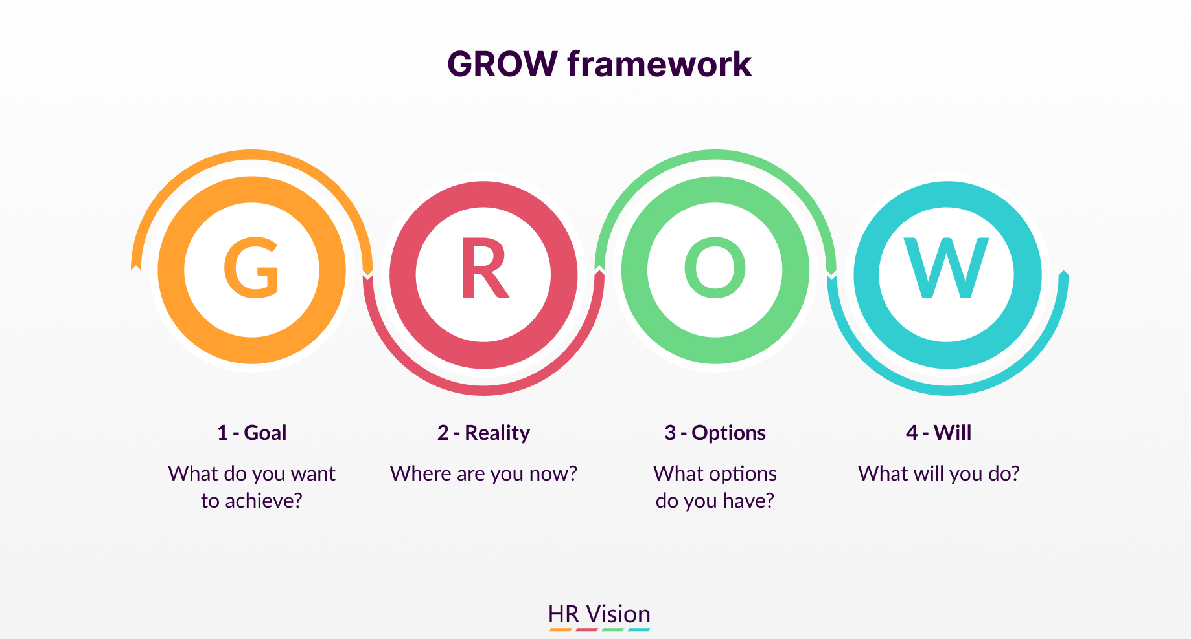

Slide 13
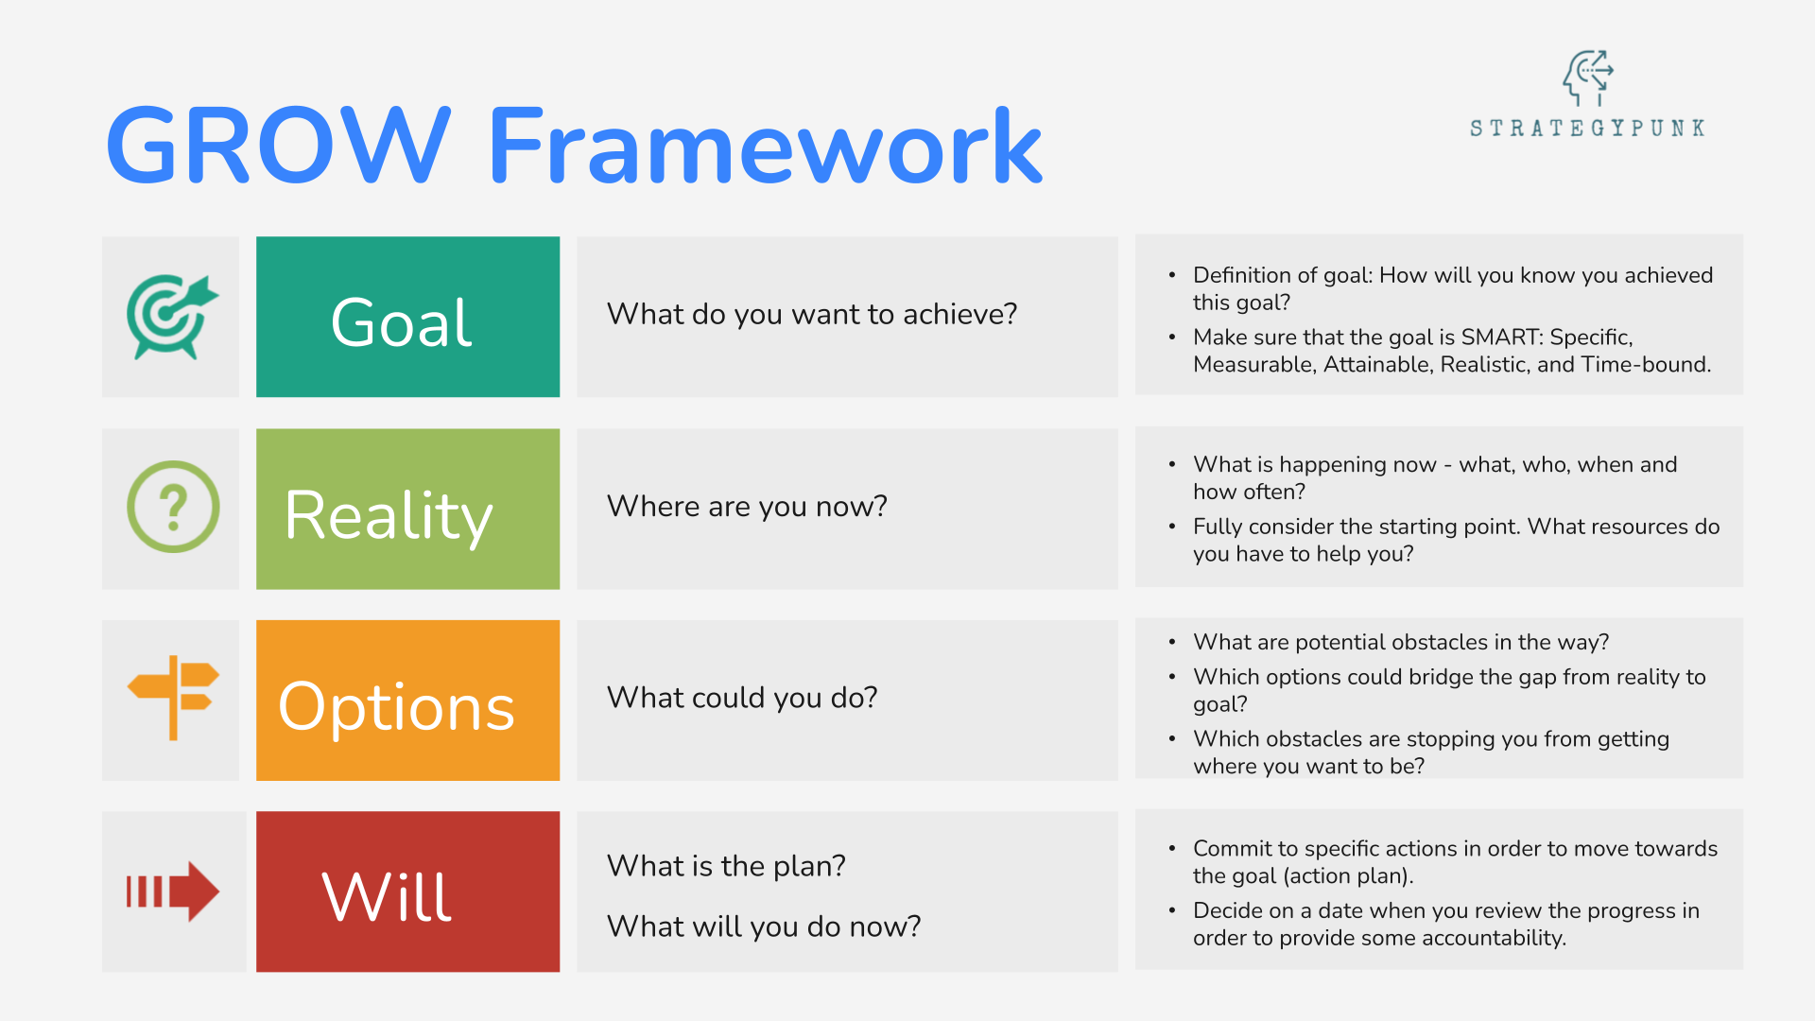

Slide 14
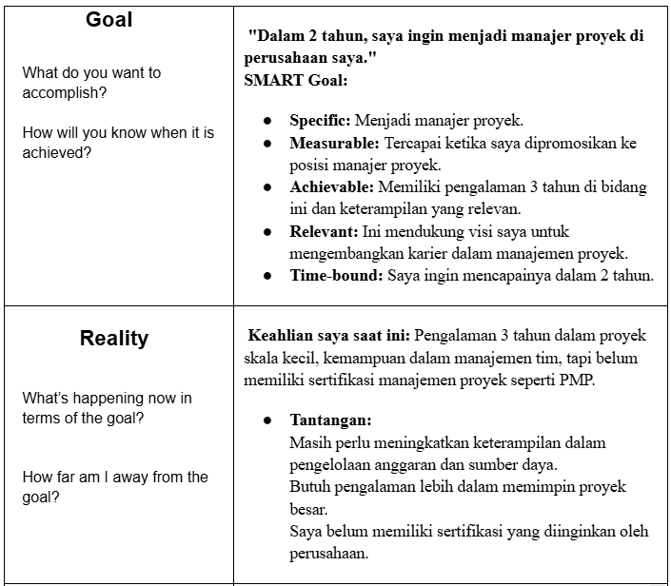
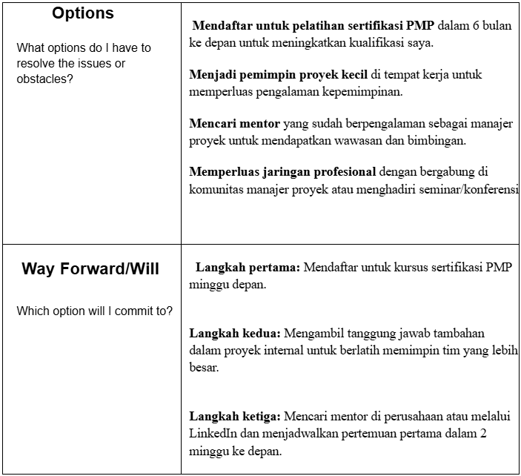

Slide 15
Practice Time

Slide 16
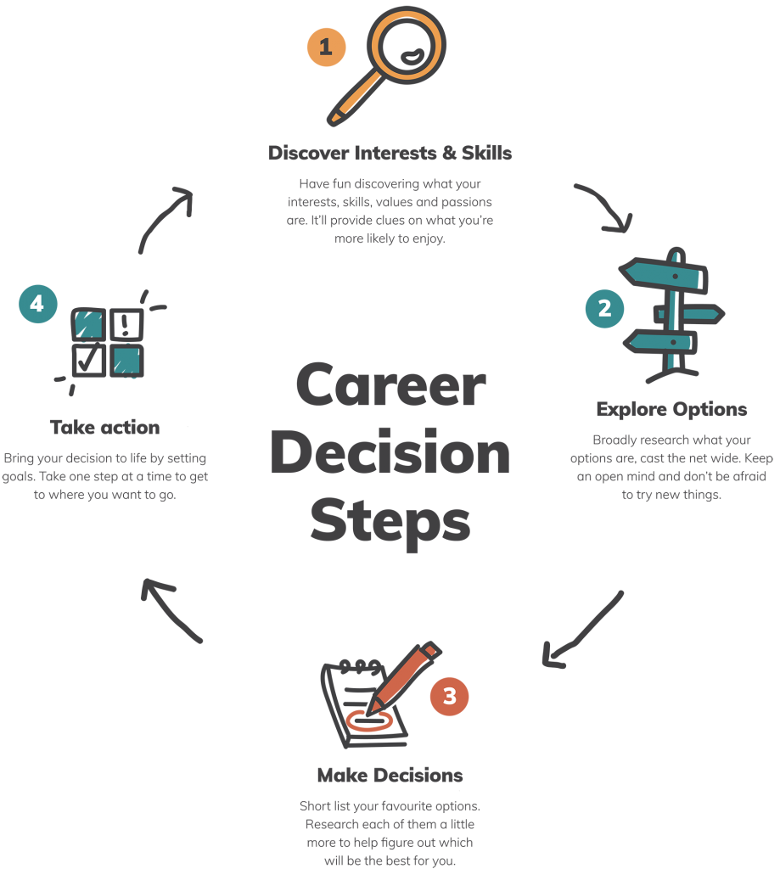

Slide 17
Terima
Kasih.

Slide 18
QnA

